Slide 1

NGO
MANAGEMENT
Course: Application Engineering and Development
Team Name: CODE MACCHAS
Notes:
IMAGE BY: Hunters Race@huntersrace (UNSPLASH)
Sean Pollock@seanpollock (UNSPLASH)

Slide 2

NGO APPLICATION
There is a growing need for nonprofit and non-governmental organizations (NGOs) throughout the world to be more effective and productive.
To implement an application for an NGO and connect multiple organizations through network to provide the necessary support to underprivileged children.
Notes:
IMAGE BY: Samson@samsonyyc (UNSPLASH)

Slide 3



OUR ENTERPRISES
GARMENT
EDUCATION
HEALTH CARE
Notes:
IMAGE BY: Marius Ciocirlan@madebymarius (UNSPLASH) Michael Dam@michaeldam (UNSPLASH) Lucas Sankey@lucassankey (UNSPLASH)

Slide 4
NEED FOR AN APPLICATION
Our goal is to build an application that provide a multi-party network through an NGO that help underprivileged and poor children get clothes, heath care and other amenities to slightly alleviate their distress.

Slide 5


APPLICATION APPROACH
NGO- Intermediary between various enterprises
Admins-Handles the payroll and employees.
Employees- Handles the volunteers and other enterprises
Volunteers-Handles the real day- to -day of the NGO
Health Services-Provide free or low-cost health care to children
Organizers-Organize heath drives
Doctors- Provide medical support
Garments- Provide excess and unused clothes to the children through the NGO.
Education - Provide academic and non-academic learning to the children by providing them professional teachers.
Notes:
IMAGE BY: Mitsuo Hirata@mitsuohirata (UNSPLASH)

Slide 6
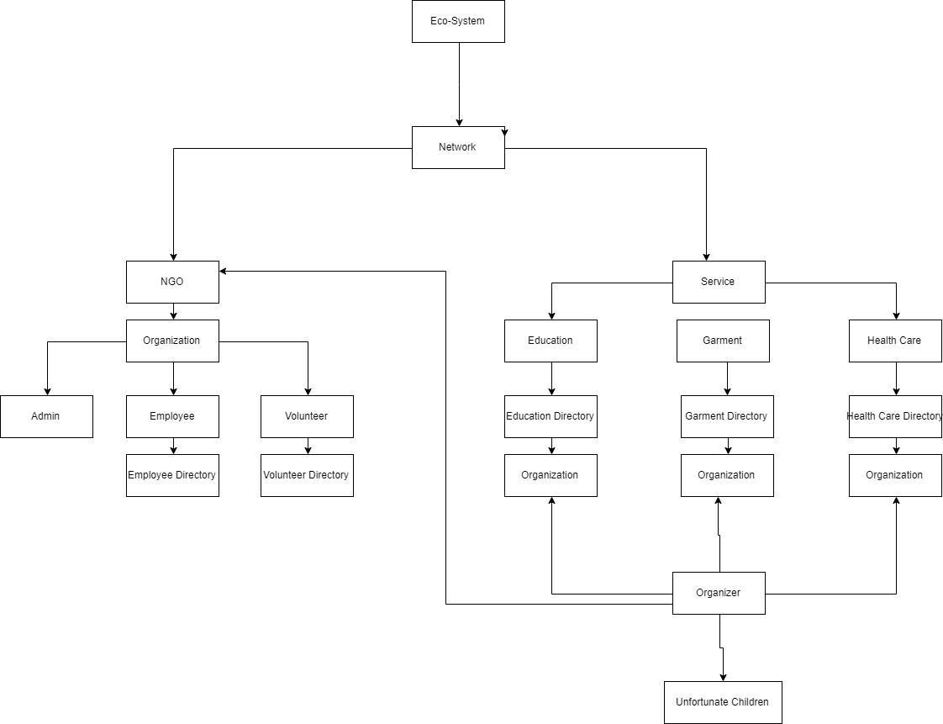
Object Model
Notes:
IMAGE BY UNSPLASH

Slide 7
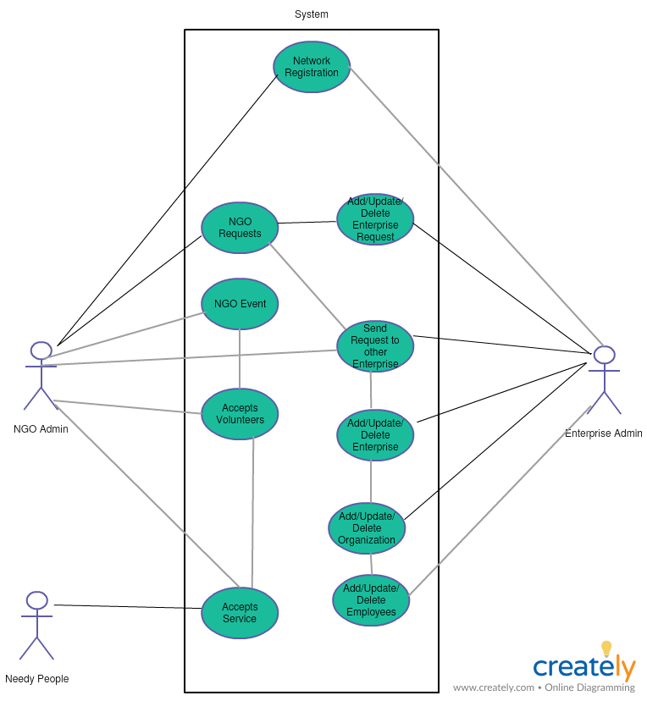
Use Case Diagram
Notes:
IMAGE BY UNSPLASH

Slide 8
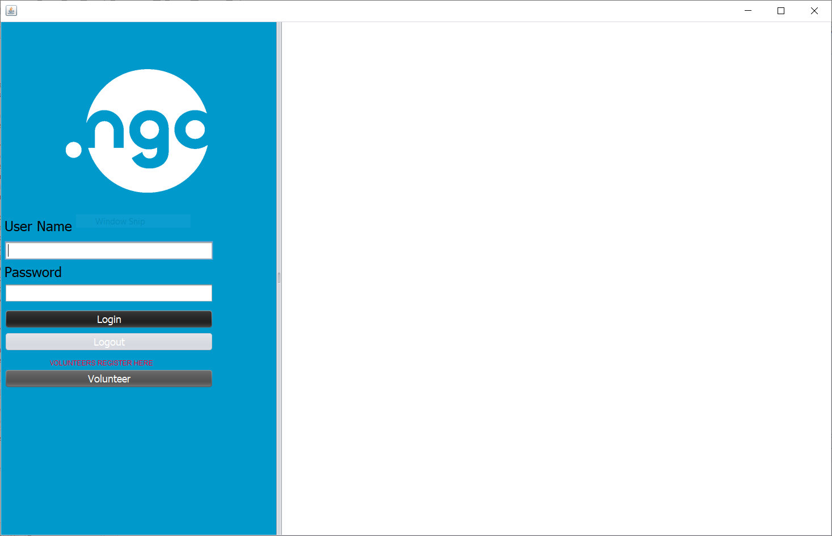
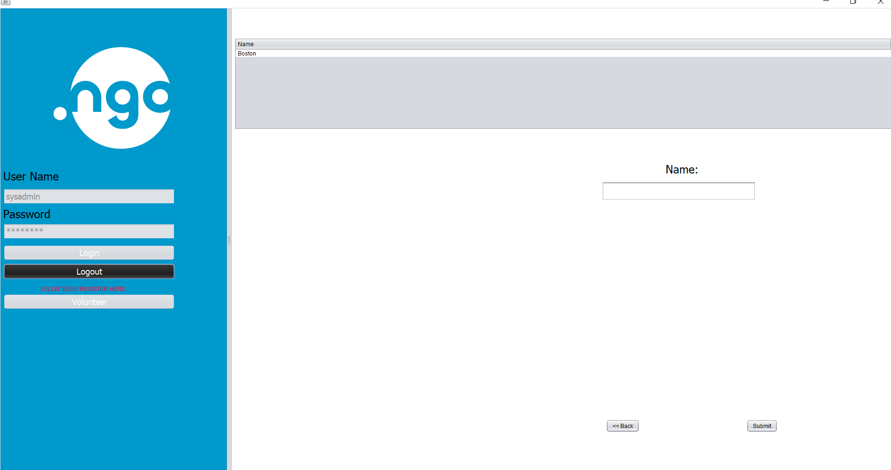
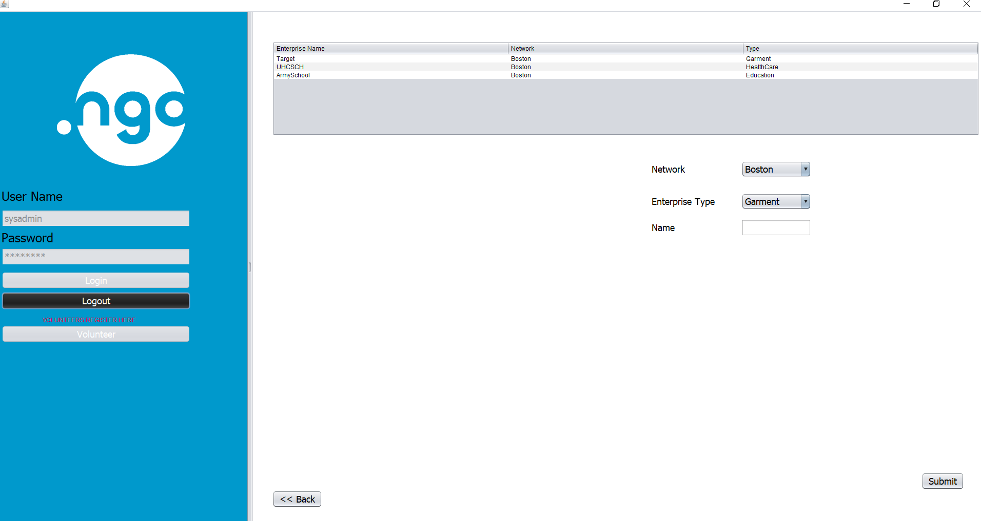
Key Screenshot
Notes:
IMAGE BY UNSPLASH

Slide 9
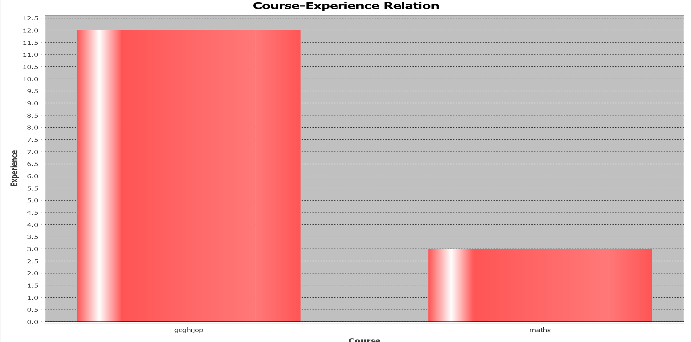
Key Screenshot
Notes:
IMAGE BY UNSPLASH

Slide 10
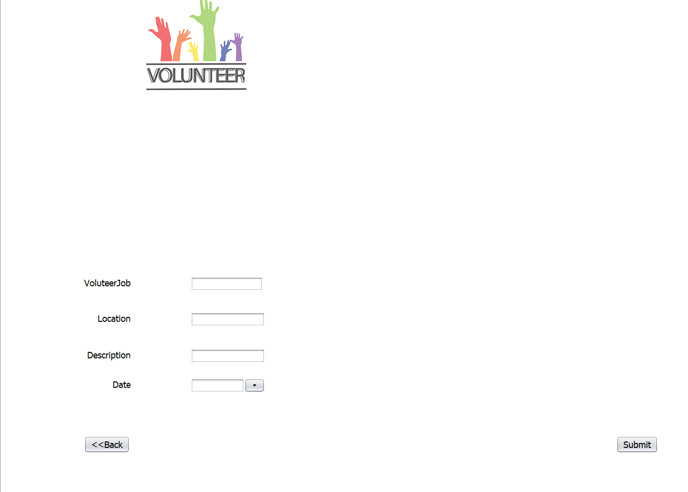
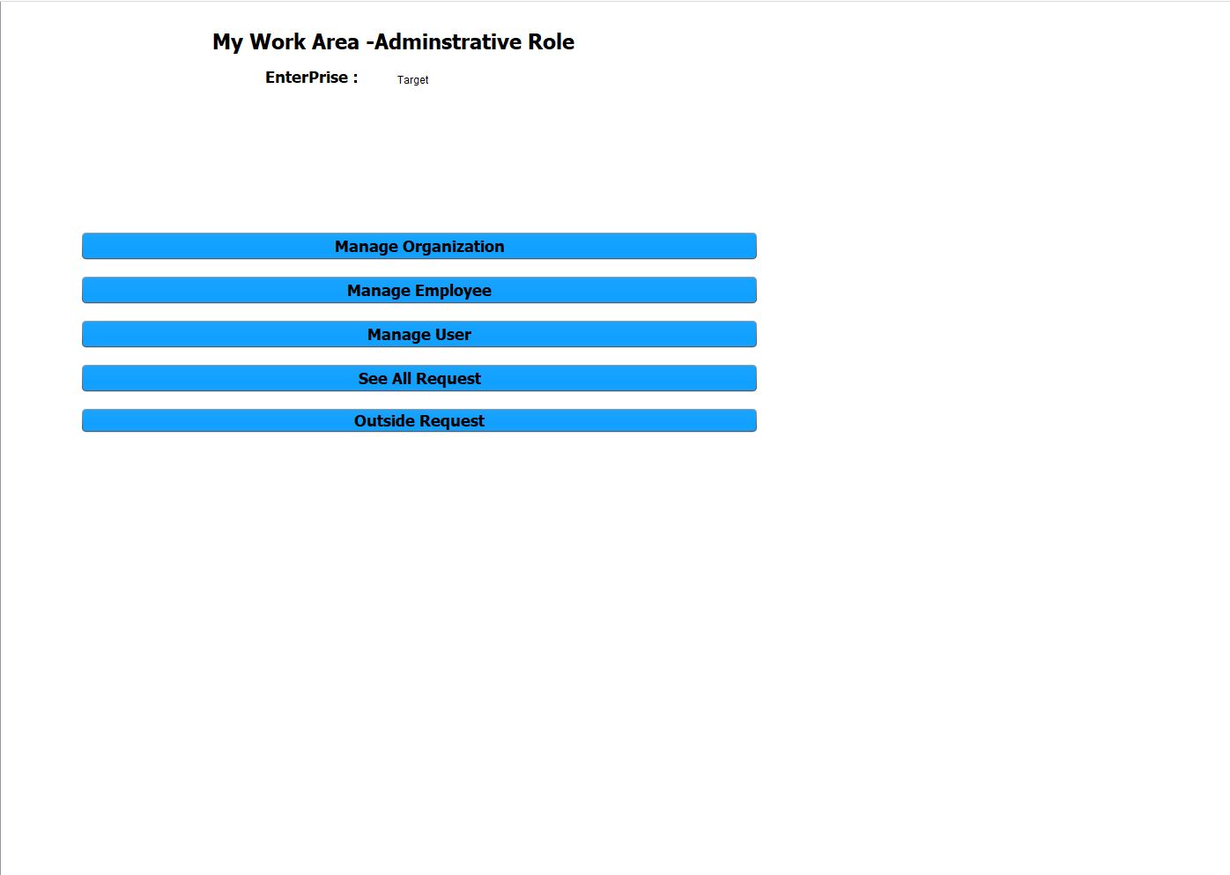
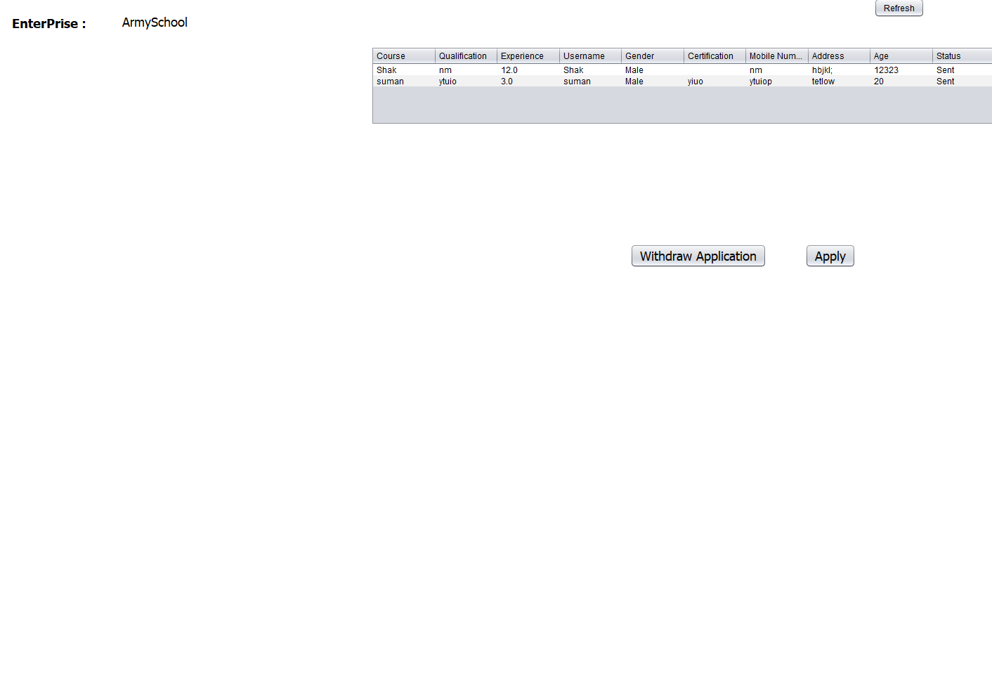
Key Screenshot
Notes:
IMAGE BY UNSPLASH

Slide 11
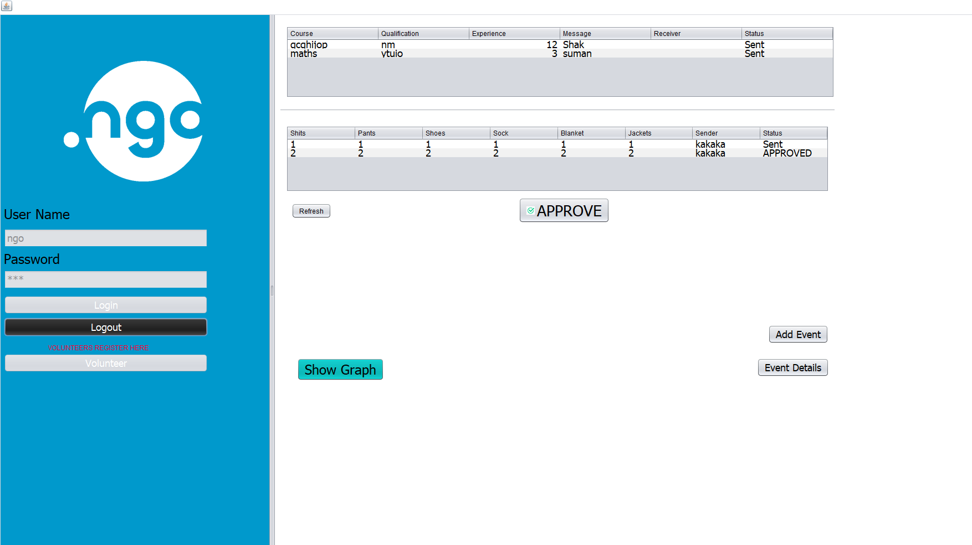
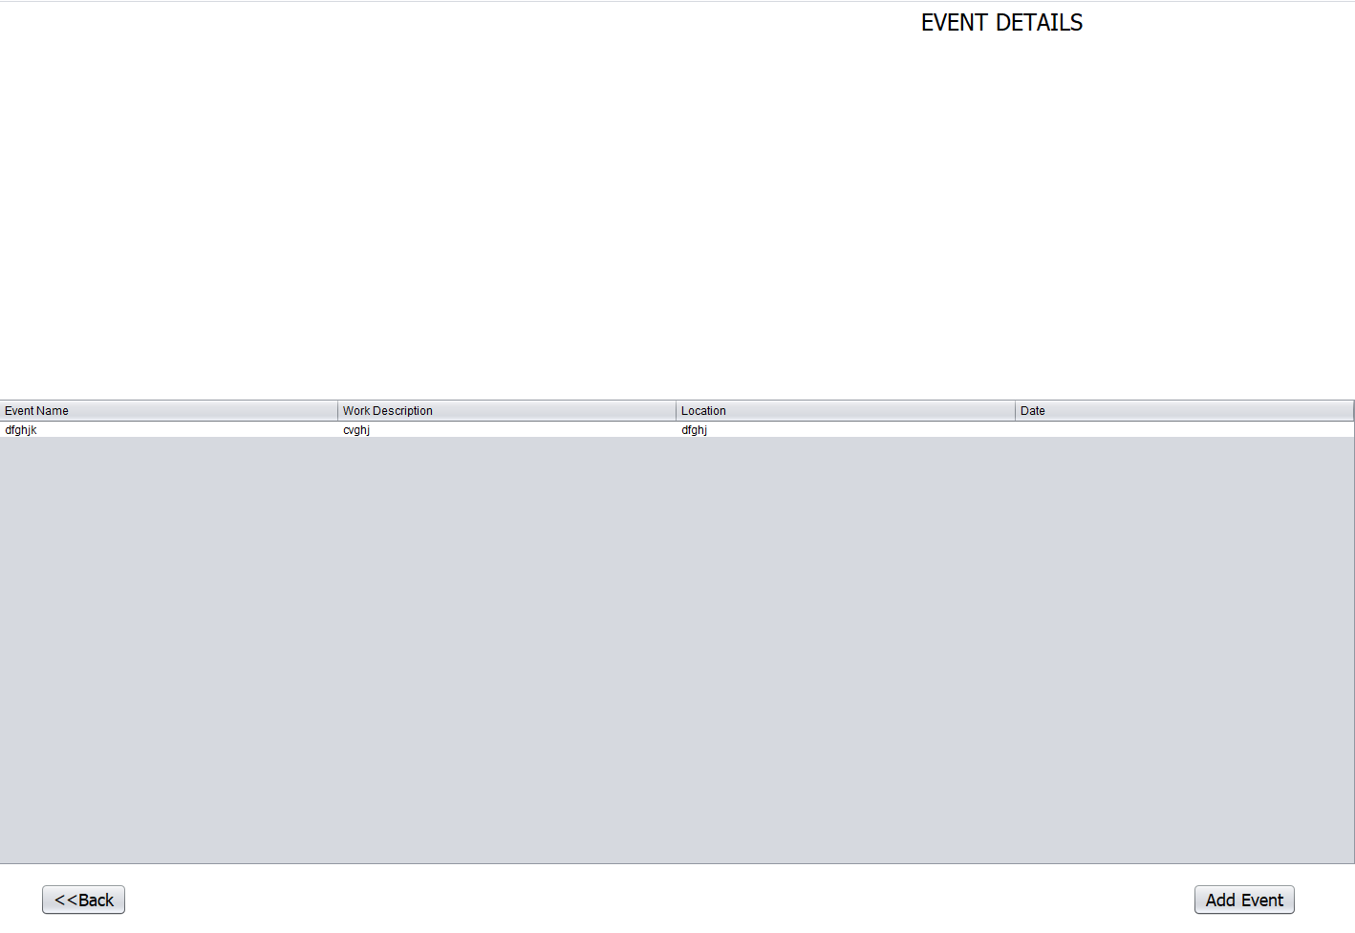
Key Screenshot
Notes:
IMAGE BY UNSPLASH

Slide 12
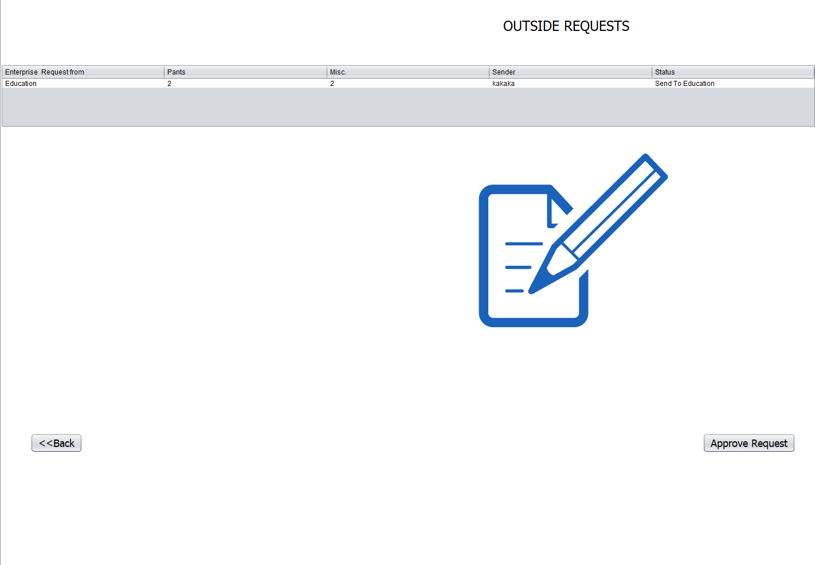
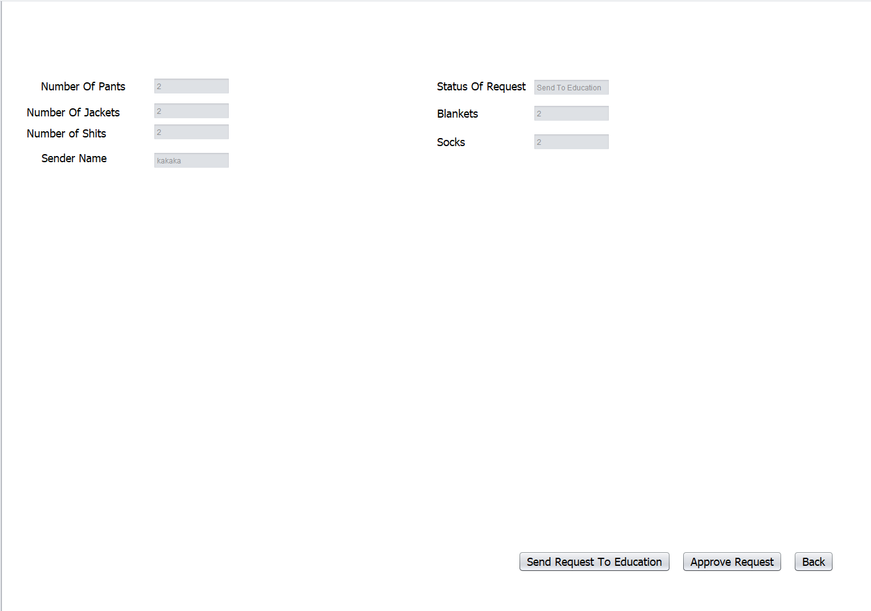
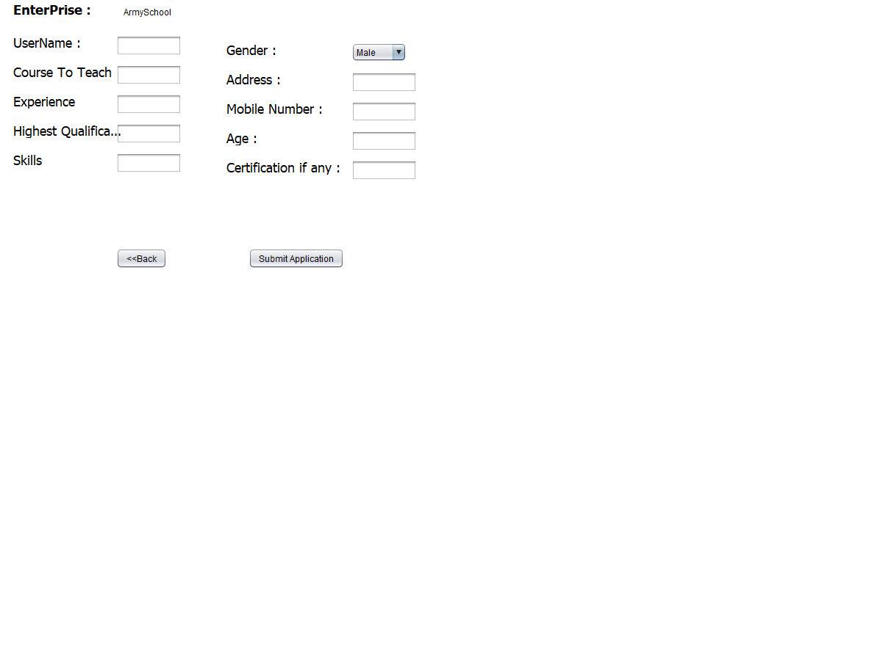
Key Screenshot
Notes:
IMAGE BY UNSPLASH

Slide 13

THANK
YOU
PITCH BOOK

